Slide 1
Different Types of Charts for Data Visualization

Slide 2
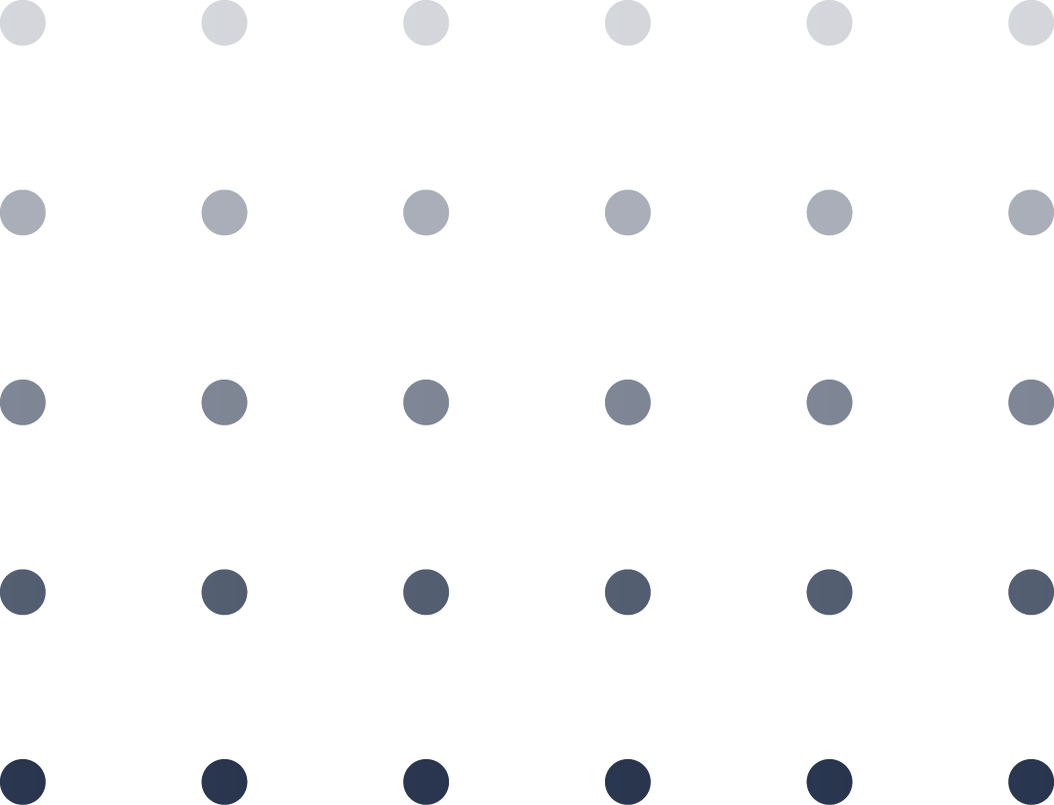
What would you like to show?
01
02
03
04
Comparison
Composition
Distribution
Relationship

Slide 3
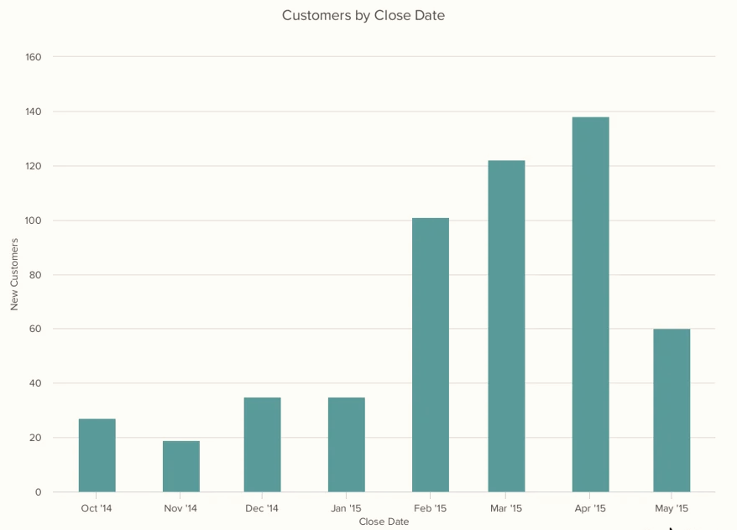
Column Charts
This chart is best used to compare different values when specific values are important.
Uses:
Use column charts for comparison if the number of categories is quite small — up to five, but not more than seven categories.
Only use column charts to show trends if there are a reasonably-low number of data points (less than 20) and if every data point has a clearly-visible value.
With column charts, you could compare values for different categories or compare value changes over a period of time for a single category.

Slide 4
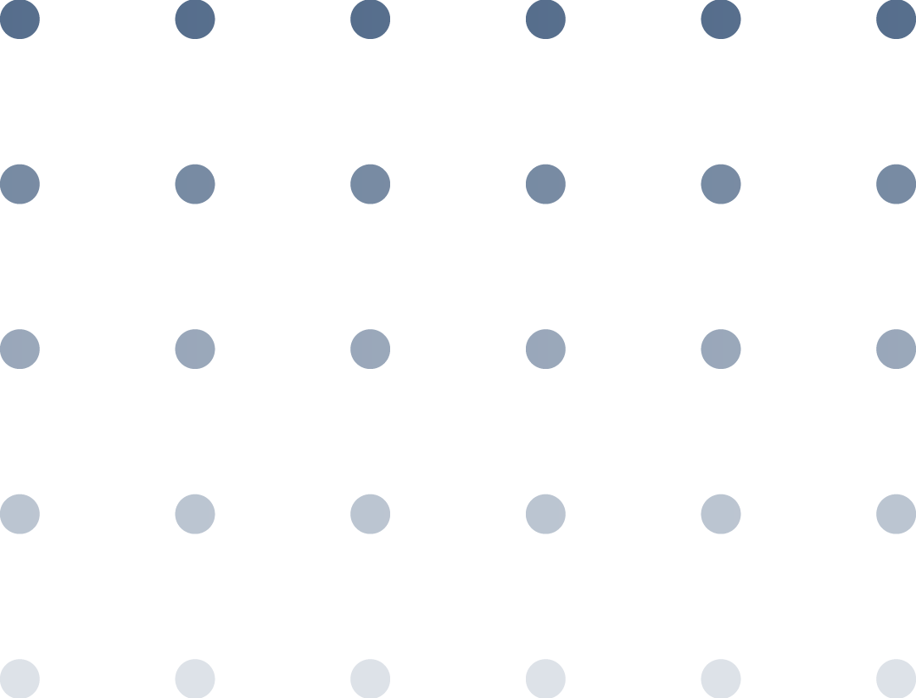
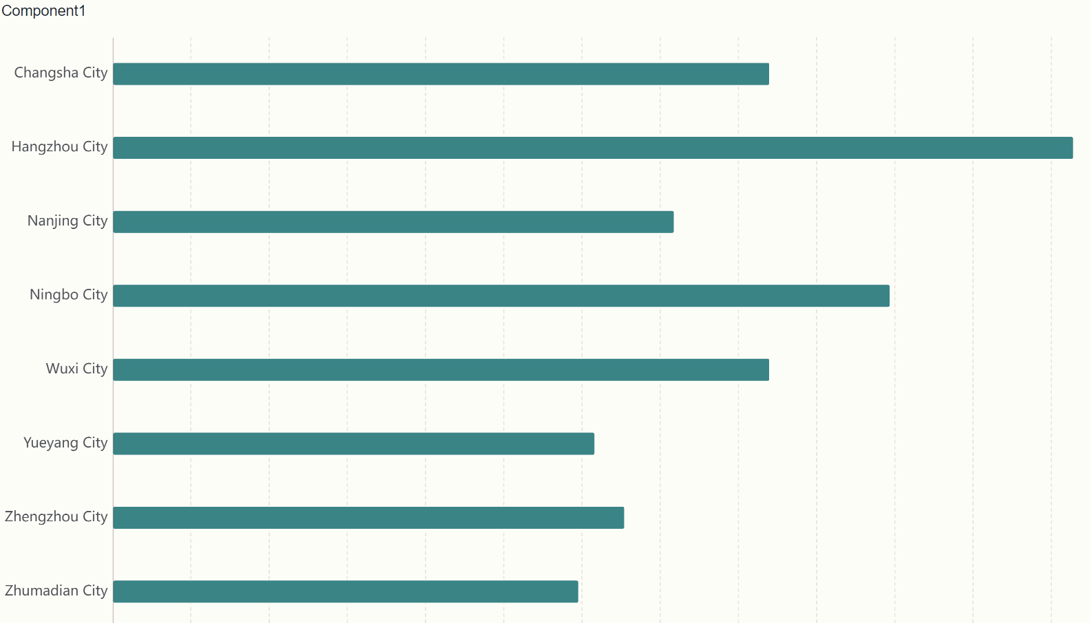
Bar Charts
Bar charts are excellent for comparing the values of different categories or groups. Apart from that, these types of charts are also helpful in showing the distribution of data across different categories.
Uses:
Bar charts can help track changes over time. Bar charts are most useful when there are big changes or to show how one group compares against other groups.
It makes it easy to see that there is more than twice the number of customers per role for individual contributors than any other group.
A bar graph also makes it easy to see which group of data is highest or most common.

Slide 5
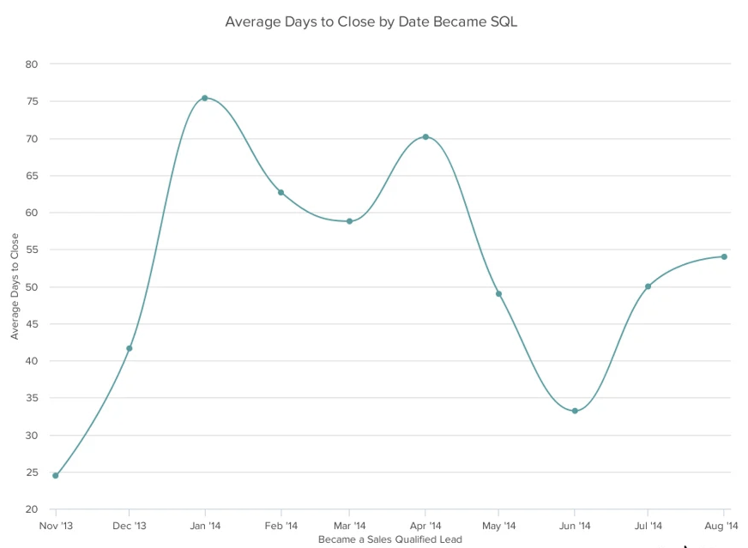
Line Charts
Line charts show changes in value across continuous measurements, such as those made over time. Movement of the line up or down helps bring out positive and negative changes, respectively.
Uses:
This type of chart helps measure how different groups relate to each other.
This type of chart is also effective for demonstrating progression, making them suitable for scenarios like project timelines, production cycles, or population growth.

Slide 6
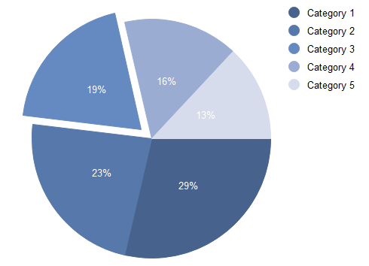
Pie Charts
Pie charts are circular visuals that dissect data into slices or segments, each representing a part of a whole. Their very design, with each slice being a portion of the circle, underscores the relationship between individual data points and the total dataset.
Uses:
This classic chart type is effective when you want to illustrate the proportion of each category in the dataset.
However, remember not to use these types of charts for large datasets, as too many slices can create confusion. The chart is suitable when you have limited categories, ideally less than six or seven.

Slide 7
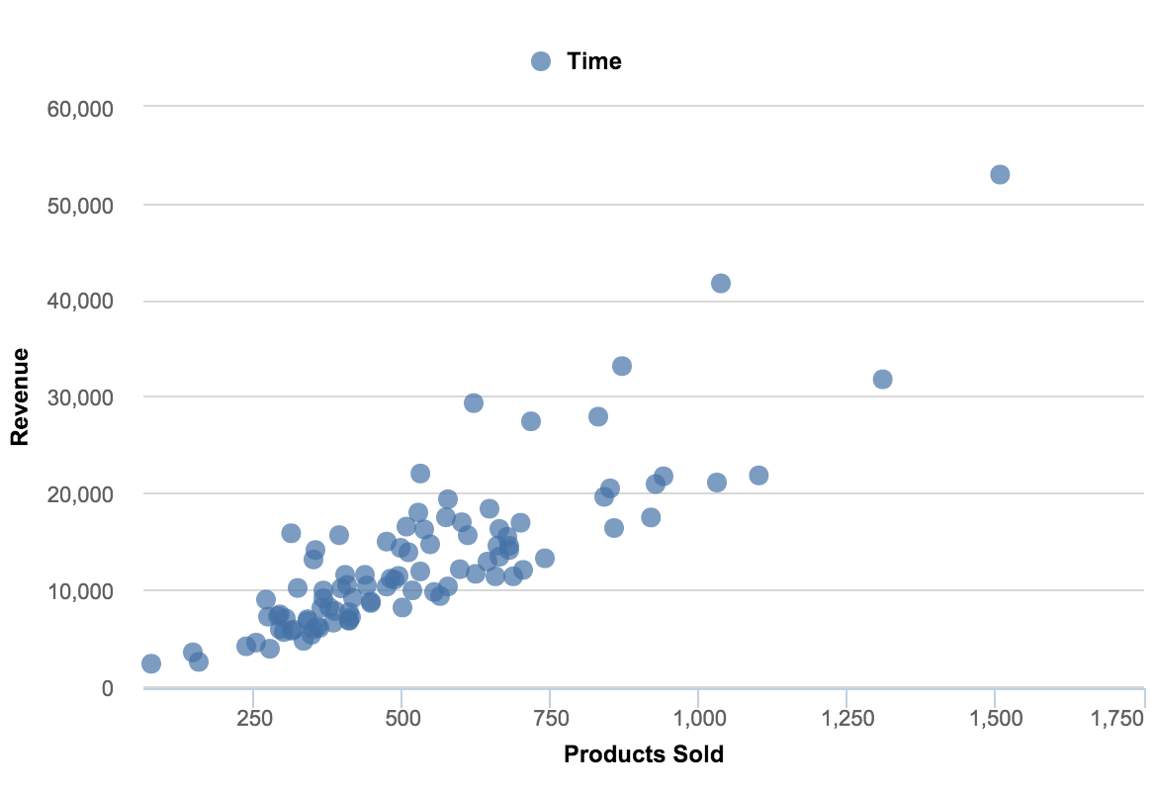
Scatter Plots
Scatter plots are types of visualization that for exploring relationships and patterns between two continuous variables. They can help to identify trends, correlations, or potential clusters in the data.
Uses:
Scatter charts are primarily used for correlation and distribution analysis. Good for showing the relationship between two different variables where one correlates to another (or doesn’t).
Scatter charts can also show the data distribution or clustering trends and help to spot anomalies or outliers.

Slide 8
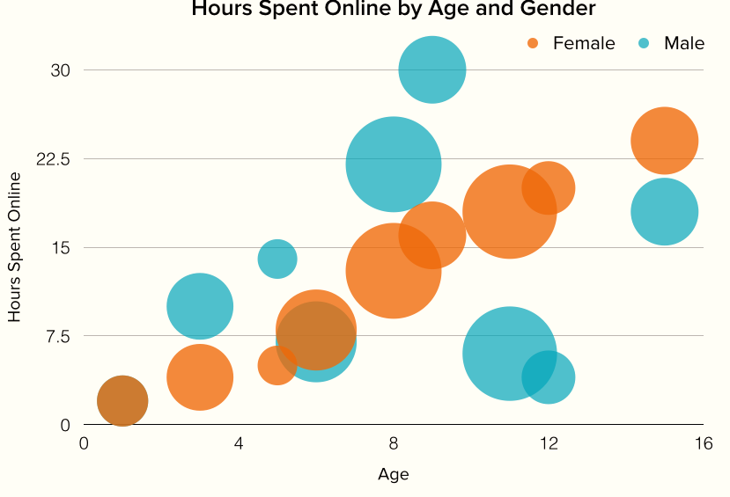
Bubble Charts
The bubble chart is a variation of the scatter chart, which helps to look at relationships between three numeric variables.
Uses:
Present relationships between two (scatter) or three (bubble) numerical variables.
Present patterns in large sets of data, linear or non-linear trends, correlations, clusters, or outliers.
Compare large number of data points without regard to time. The more data you include in a scatter chart, the better comparisons you can make.
Present relationships, but not exact values for comparisons.

Slide 9
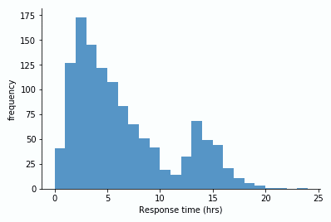
Histogram
A histogram looks similar to a bar chart at first glance, but it serves a distinct purpose. Instead of comparing discrete categories, histograms showcase the distribution of continuous data by segmenting it into intervals or “bins”.
Uses:
Think of histograms as a more informative way to view the distribution or values in a dataset. It is ideal for visualizing the spread and variation of the data.
It helps to identify outliers or unusual data points that fall far outside the normal range of the data.

Slide 10
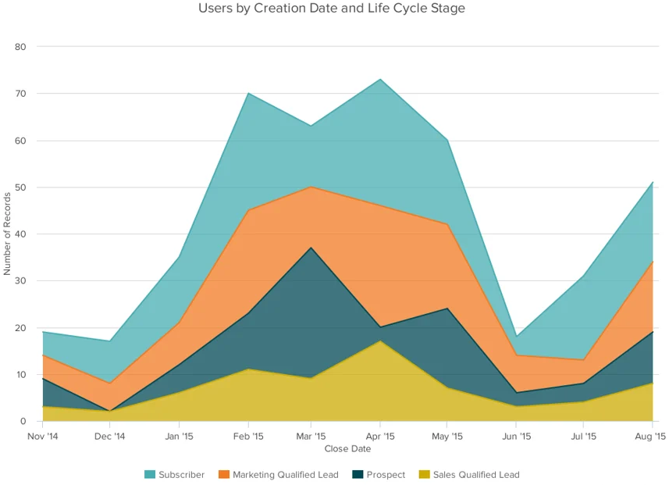
Area Charts
An area chart is a graphical representation of quantitative data, emphasizing the magnitude of change over time. Unlike a line chart, it fills the area beneath the line, making it more visually striking and useful for illustrating cumulative values.
Uses:
Apart from visualizing cumulative values, area charts are ideal for showing how values change, such as monthly revenue figures, yearly marketing performance, or daily sales estimates.
These charts make the size of a group and how groups relate to each other more visually important than data changes over time.

Slide 11
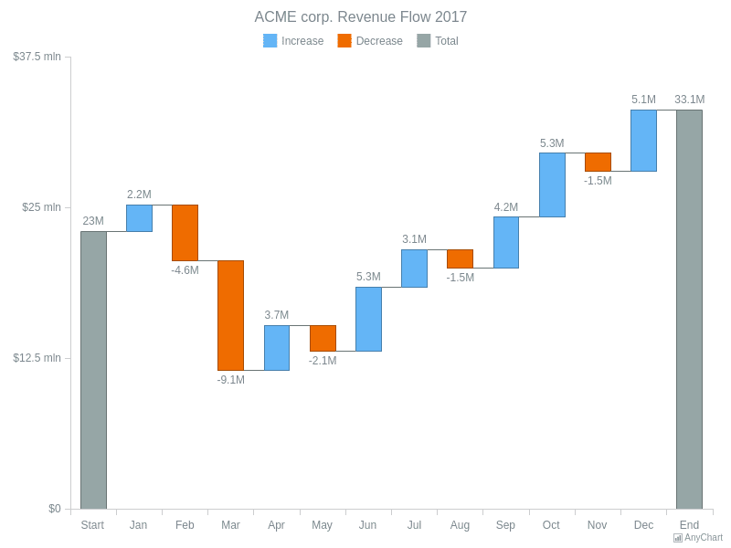
Waterfall Charts
A waterfall chart is a type of graph that usually shows positive and negative values of change between two points, which helps in understanding the cumulative effect of these changes (so the net change).
Uses:
This chart does not only look at the starting value and the ending value of your data set but also visualized each individual positive or negative change that happened.
This type of chart is quite useful in financial sectors or human resources, but also in other industries (think of inventories, revenue tracking, etc.
This type of visualization helps communicate the sequential impact of various factors on a total value. The chart helps visualize the changes in the data and understand the flow of values.

Slide 12
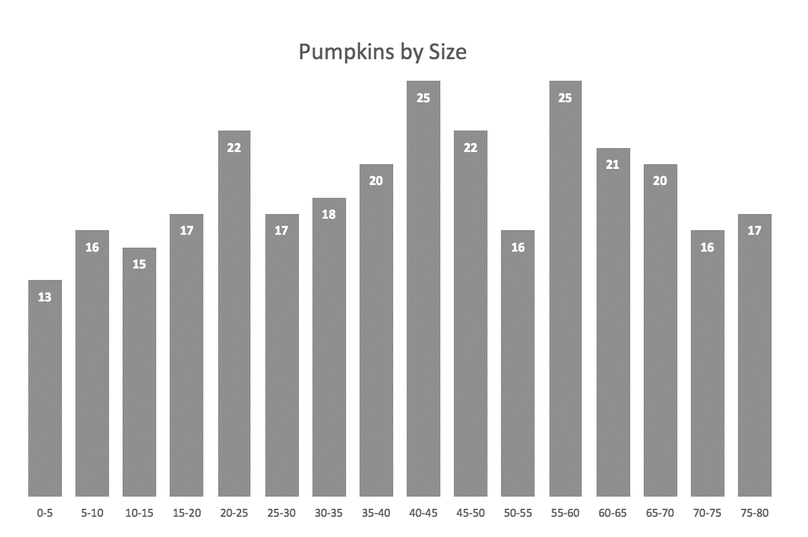
Column Histogram
A histogram is a common variation of column charts used to present the distribution and relationships of a single variable over a set of categories.
A good example of a histogram would be a distribution of grades on a school exam or the sizes of pumpkins, divided by size group, in a pumpkin festival.

Slide 13
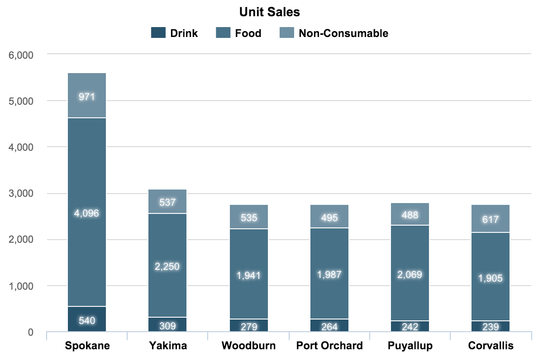
Stacked Column Charts
Use stacked column charts to show a composition. Do not use too many composition items (not more than three or four) and make sure the composing parts are relatively similar in size. It can get messy very quickly.

Slide 14
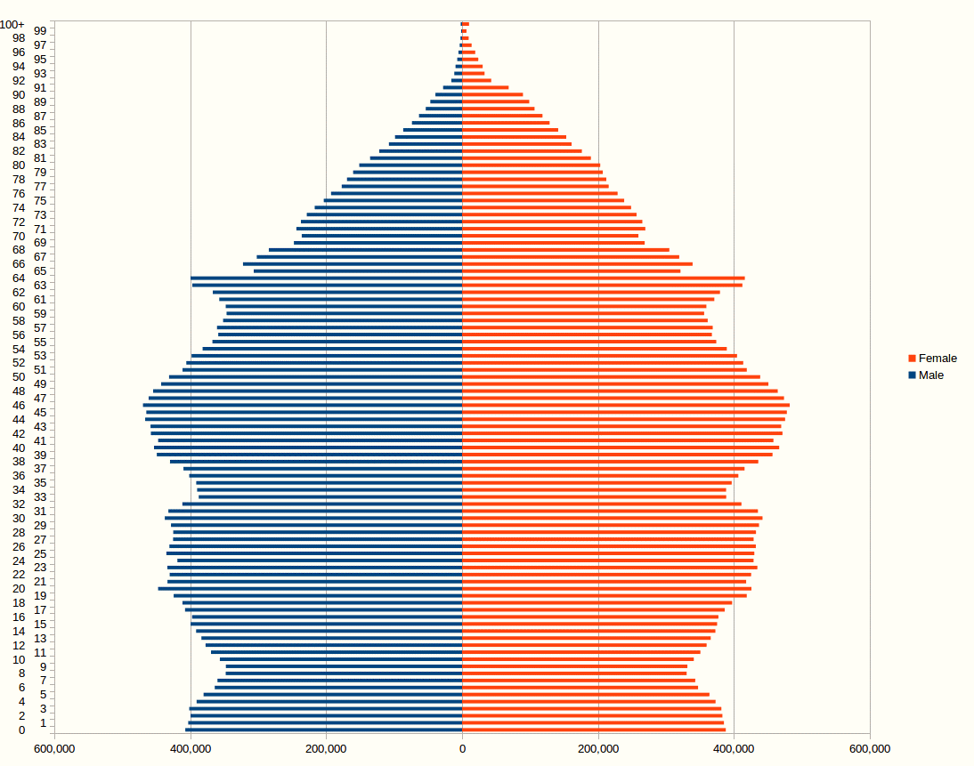
Bar Histogram Charts
Just like column charts, bar charts can be used to present histograms.

